Slide 1
NLP Project 1
程智聪 韩冬 张坚

Slide 2
Agenda
Data Preprocessing
Feature Extracting
Classifying
Result Analyzing

Slide 3
Data Preprocessing
XML library: XOM 1.1
Missing POS tags: na, nx, Ug
Customized POS tag: *
Handling subword
Handling multiple target items in the context
面临我国心脑血管疾病发病和死亡率逐年上升的严重趋势，现任中国<head>中医</head>研究院长城医院院长的周文志教授历时30余年艰辛探索，采用中医中药方法治疗和预防心脑血管疾病取得显著成果。

Slide 4
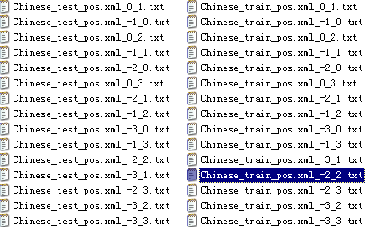
Feature Extracting
StartOffset and EndOffset
吴宏权<head>使</head>出全身
StartOffset = -2
0
EndOffset = 2
nr,nr,v,n,use

Slide 5
Classifying
Data mining library: Weka 3.6
Classifier
  MLP
    L: 0.6
    H:12, 4, (adaptive)
    M: 0.9
  SMO
    NormalizedPolyKernel
  NaiveBayes

Slide 6
Result Analyzing
 | NaiveBayes | SMO | MLP
Range：-30 | 0.560427807 | 0.580748663
Range：-31 | 0.628877005 | 0.664171123
Range：-32 | 0.639572193 | 0.659893048
Range：-33 | 0.636363636 | 0.673796791
Range：-20 | 0.56684492 | 0.562566845
Range：-21 | 0.639572193 | 0.653475936
Range：-22 | 0.657754011 | 0.670588235
Range：-23 | 0.648128342 | 0.68342246
Range：-10 | 0.561497326 | 0.580748663
Range：-11 | 0.652406417 | 0.682352941 | 0.61
Range：-12 | 0.652406417 | 0.671657754
Range：-13 | 0.648128342 | 0.681283422
Range：01 | 0.580748663 | 0.586096257
Range：02 | 0.583957219 | 0.609625668
Range：03 | 0.581818182 | 0.618181818

Slide 7
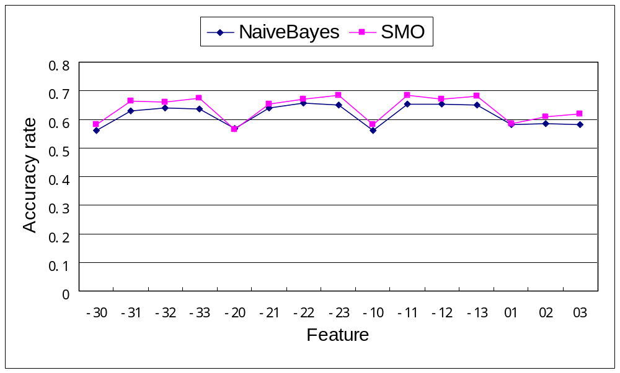
Result Analyzing

Slide 8
Q & A
Thanks

